Slide 1


ONLINE E-COMMERCE SITE [ ECOMART ]
TEAM MEMBERS: AYUSH BHARTI
CHIRAG KUMAR
HIMANSHU MEHTA
ROLL NO. 2210990204
2210990240
2210990406

Slide 2



SHOP SMART WITH
ECOMART

Slide 3

Step into the World of Shopping
Welcome to our Online E-commerce Platform! Our
dedicated team at ECOMART is committed to revolutionizing your digital experience.
We specialize in streamlining digital processes, from
digitizing analog objects to managing metadata efficiently.
With our innovative Shop Management System,
organizing your online store has never been easier.
Our user-friendly interface and robust features
empower you to effortlessly manage your inventory,
track sales, and gain valuable insights into member
purchases.
Experience the future of online shopping with us at Ecomart
Ecommerce Data Site, where innovation meets seamless
functionality.

Slide 4



OBJECTIVES OF E-COMMERCE
3. Improving Customer Satisfaction
1. User-Friendly Interface
2. Interactive Platform

Slide 5

Planning
Your message
Select a theme and tone that resonate with your audience, whether it's your Instagram followers, environmental enthusiasts, or friends. Create engaging content, like images, videos, or text, that aligns with your goals and speaks to the preferences of your target audience

Slide 6
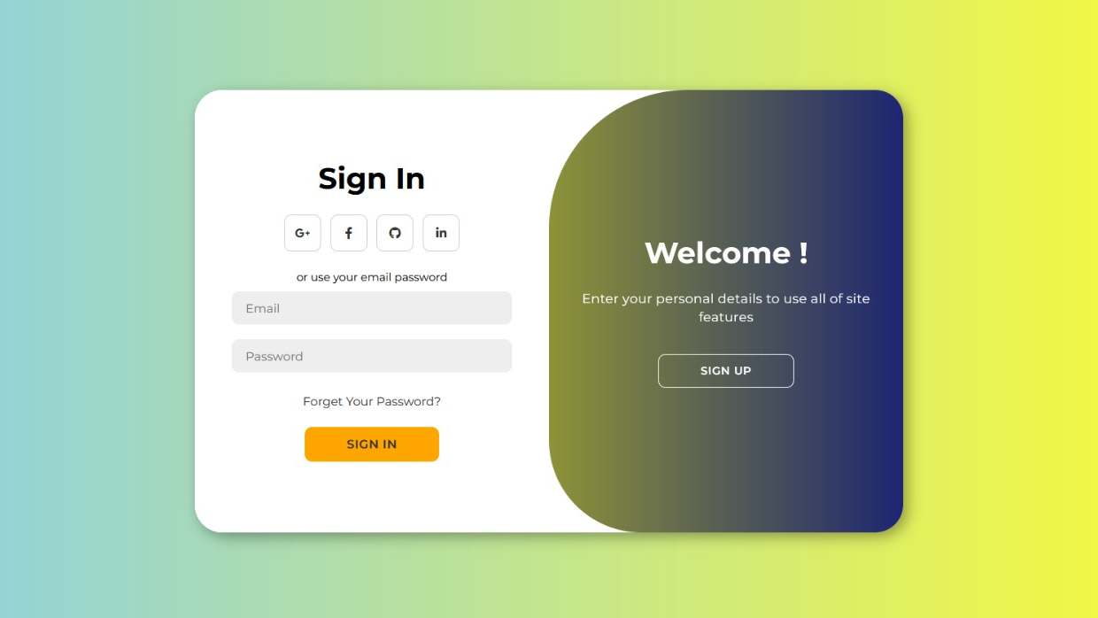
SIGN IN / SIGN UP PAGE

Slide 7

FRONT VIEW

Slide 8


Slide 9
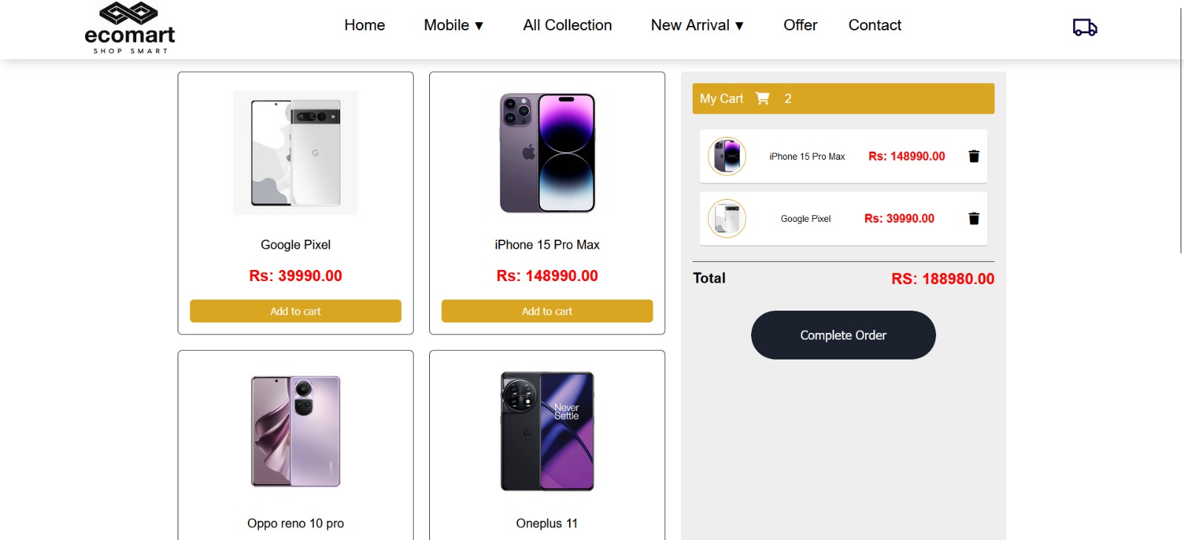

Slide 10

CONCLUSION
Embrace on a journey of convenience with our E-commerce website (ecomart) and experience the joy of shopping with us .

Slide 11
REFERENCES
www.w3school.com
www.croma.com
www.google.com

Slide 12


Roadmap infographic of our socials
Initiative | Objective | Jan | Feb | Mar | Apr | May | Jun | Jul | Aug | Sep | Oct | Nov | Dec
Dance trend | Make a video of our team following the newest trend on TikTok
A day in my life | Showing the most human side of our company
Anniversary giveaway | Generate engagement and get new followers
“How it’s made” | Show our creative process and engage new followers
Live on TikTok | Create a webinar to show new clients how to use our products
Instagram contest | Get more people to speak about us and use our hashtag “#company”

